Slide 1

Online job portal
Presented By
Somesh Ghuge & Hemant Budhe

Slide 2

Index
Introduction
Architecture
Technology platform used for project
User roles and responsibilities
Future extensions or scope
Conclusion

Slide 3

Introduction
Purpose :-
Our project, the "Online Job Portal," aims to make job hunting and hiring simpler. We're creating a user-friendly platform where job seekers easily find and apply for jobs. Employers also benefit by effortlessly posting job openings. This web application minimizes manual work, making job searching and recruitment smoother for everyone involved.

Slide 4

Architecture :-
Front End :- React JS (Version 18) , Bootstrap
Back End :- Java 11, Spring Boot REST API, JPA
Database :- MySQL 8.0. 34

Slide 5

Reason for selecting the specific technology :-
React allows developers to create large web applications that can change data, without reloading the page. The main purpose of React is to be fast, scalable, and simple. It works only on user interfaces in the application.
Spring Boot provides a flexible way to configure Java Beans, XML configurations, and Database Transactions. It provides a powerful batch processing and manages REST endpoints. In Spring Boot, everything is auto configured; no manual configurations are needed.

Slide 6

User Roles And Responsibilities :-
Online Job Portal consists of three roles described as below :-
Admin
Freelancer
Recruiter

Slide 7



User Classes
Job Seeker
Recruiter
Admin
In this module Job Seeker will register, update details or and can apply for the various jobs and view responses on applied jobs.
In this module Job Providers can register and after verification by admin can add new jobs and view the list of applicants applied for that specific job. Also they can accept and reject the applications.
In this module Admin can manage job Seekers and Job Providers. Will verify the job providers.

Slide 8
Jobseeker Module
After successful registration ,the job seeker can
Search for the jobs in various fields depending upon the availability
of jobs.
Can edit his/her profile ,
Delete account and
Check the response of any job he/she has applied for earlier in
status option.

Slide 9
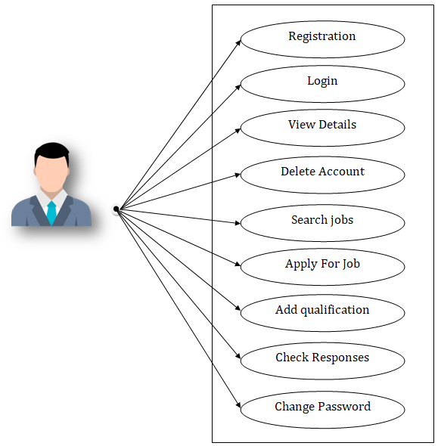
Use Case diagram for Job Seekers

Slide 10

Job Provider Module
After successful registration and authentication from Admin , the job provider can
Upload new jobs for the in various fields. Apart from this,
The job provider can edit his/her profile ,
Can Delete their account
Check the applicant who has applied For different jobs
Shortlist them by sending the message .

Slide 11
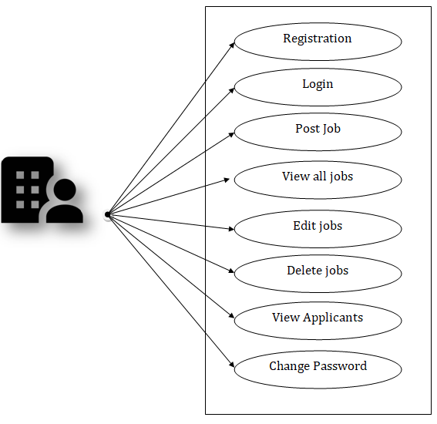
Use Case diagram for Job Providers

Slide 12
Admin Module
The Admin can
Approve or disapprove the job providers.
He /she can see applicant details ,
Manage account and delete job providers account.

Slide 13
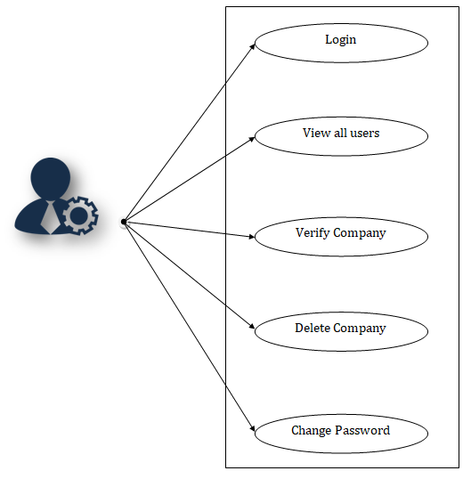
Use Case diagram for Admin

Slide 14

Future extensions or scope :-
AI-Powered Recommendations:
Personalized job suggestions for seekers and employers.
Remote Work Focus:
Highlight remote and flexible opportunities.
Skill Assessment:
Skill tests to showcase abilities on profiles.
Mobile App Development:
Access via smartphones with a mobile app.

Slide 15
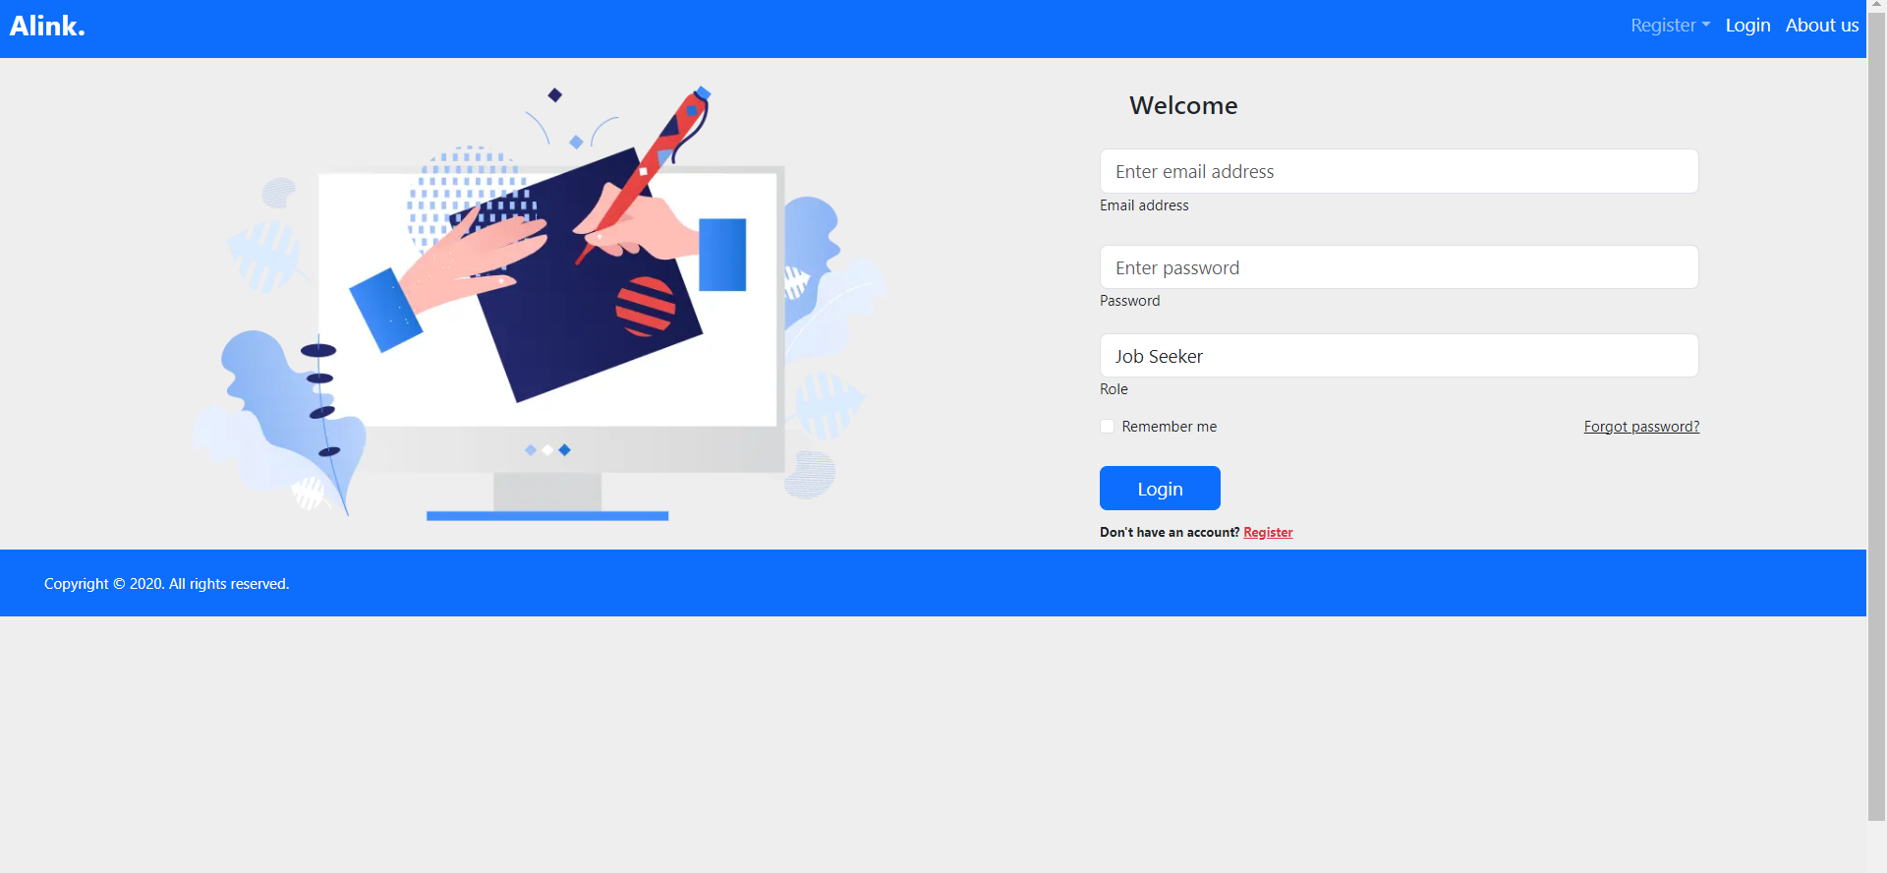
Front Login view

Slide 16
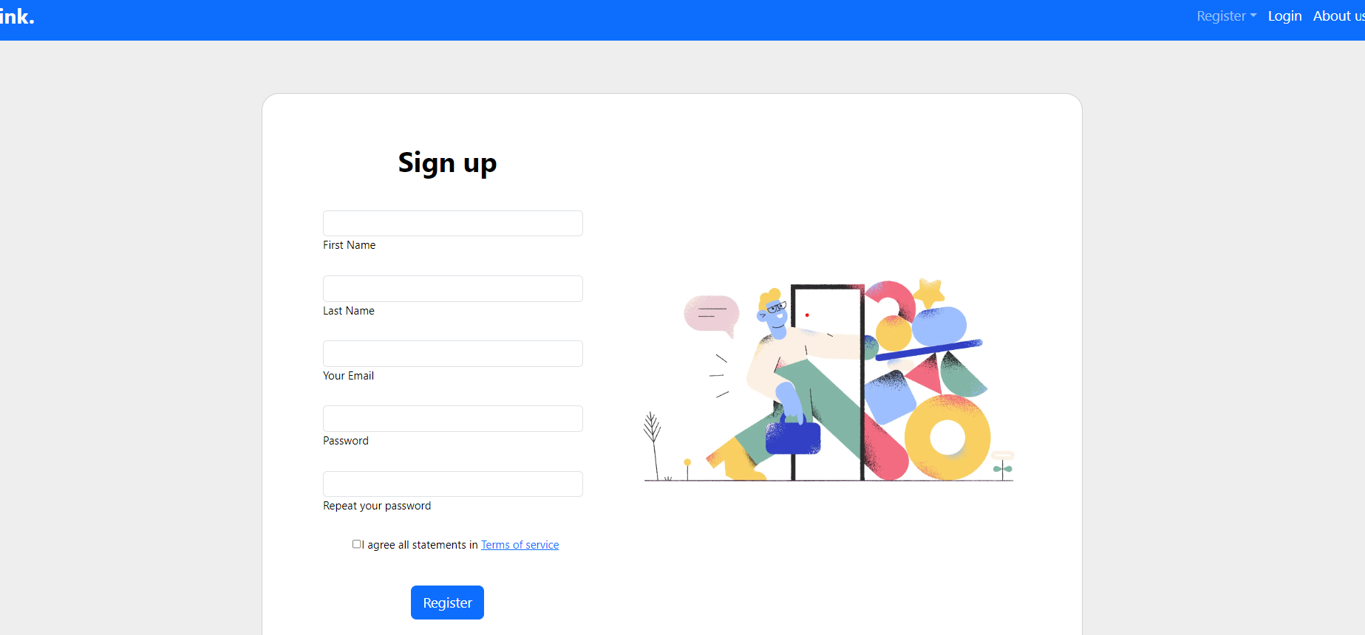
JobSeeker Registration

Slide 17
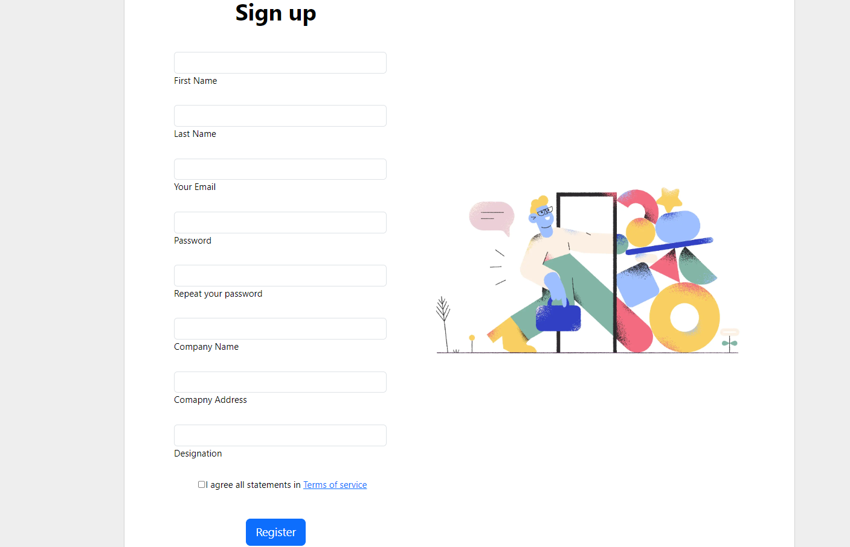
Employer Registration

Slide 18
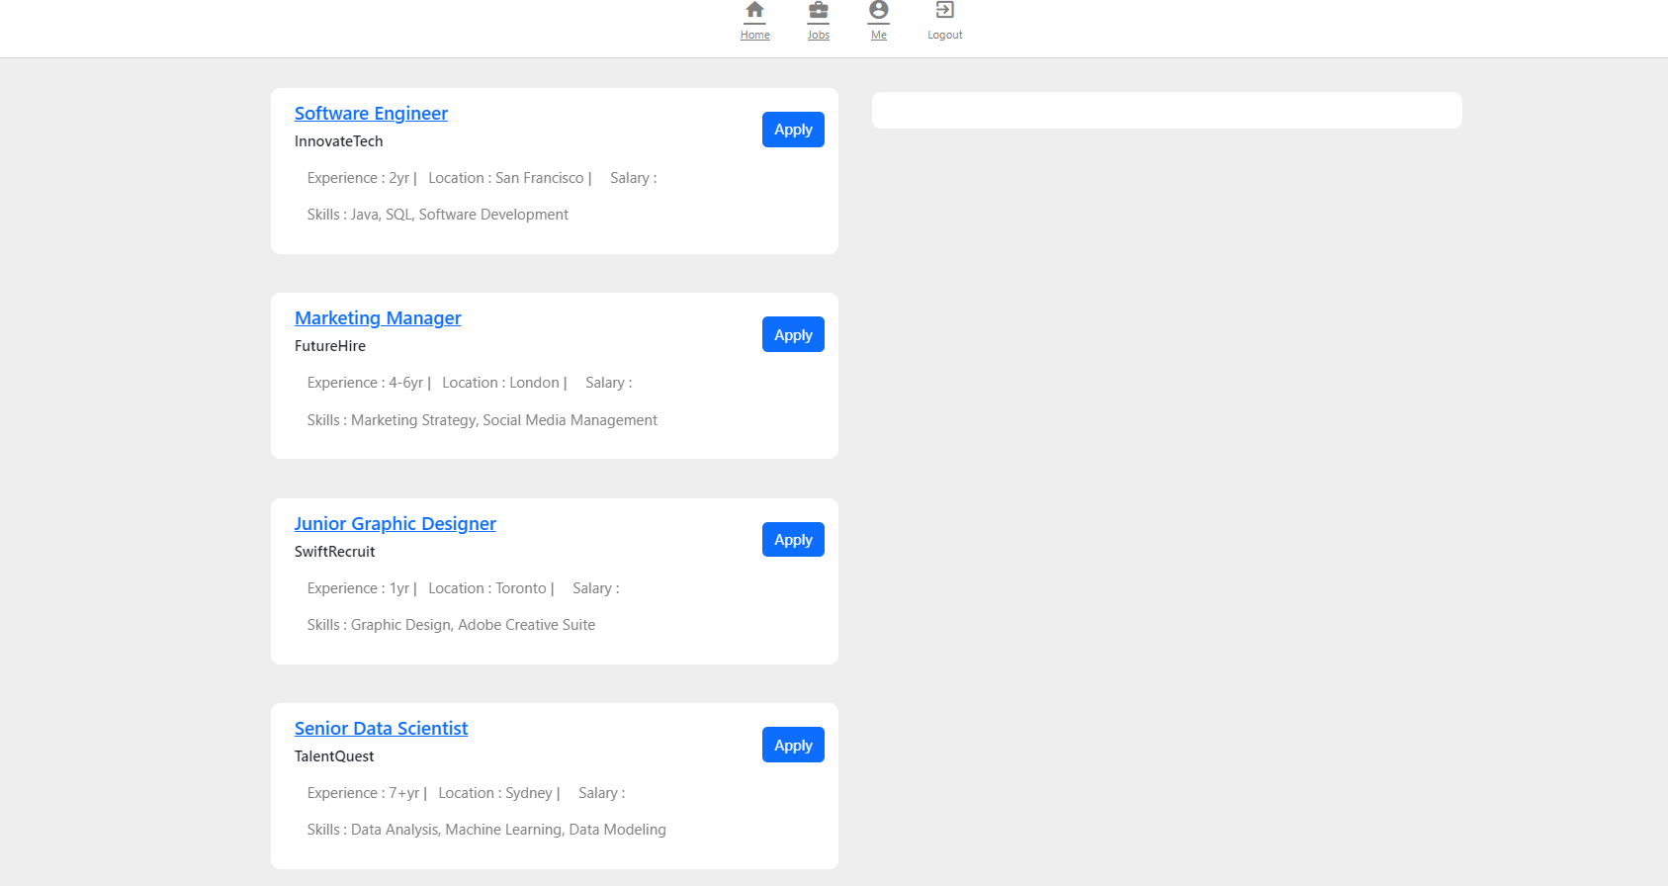
Job List View

Slide 19
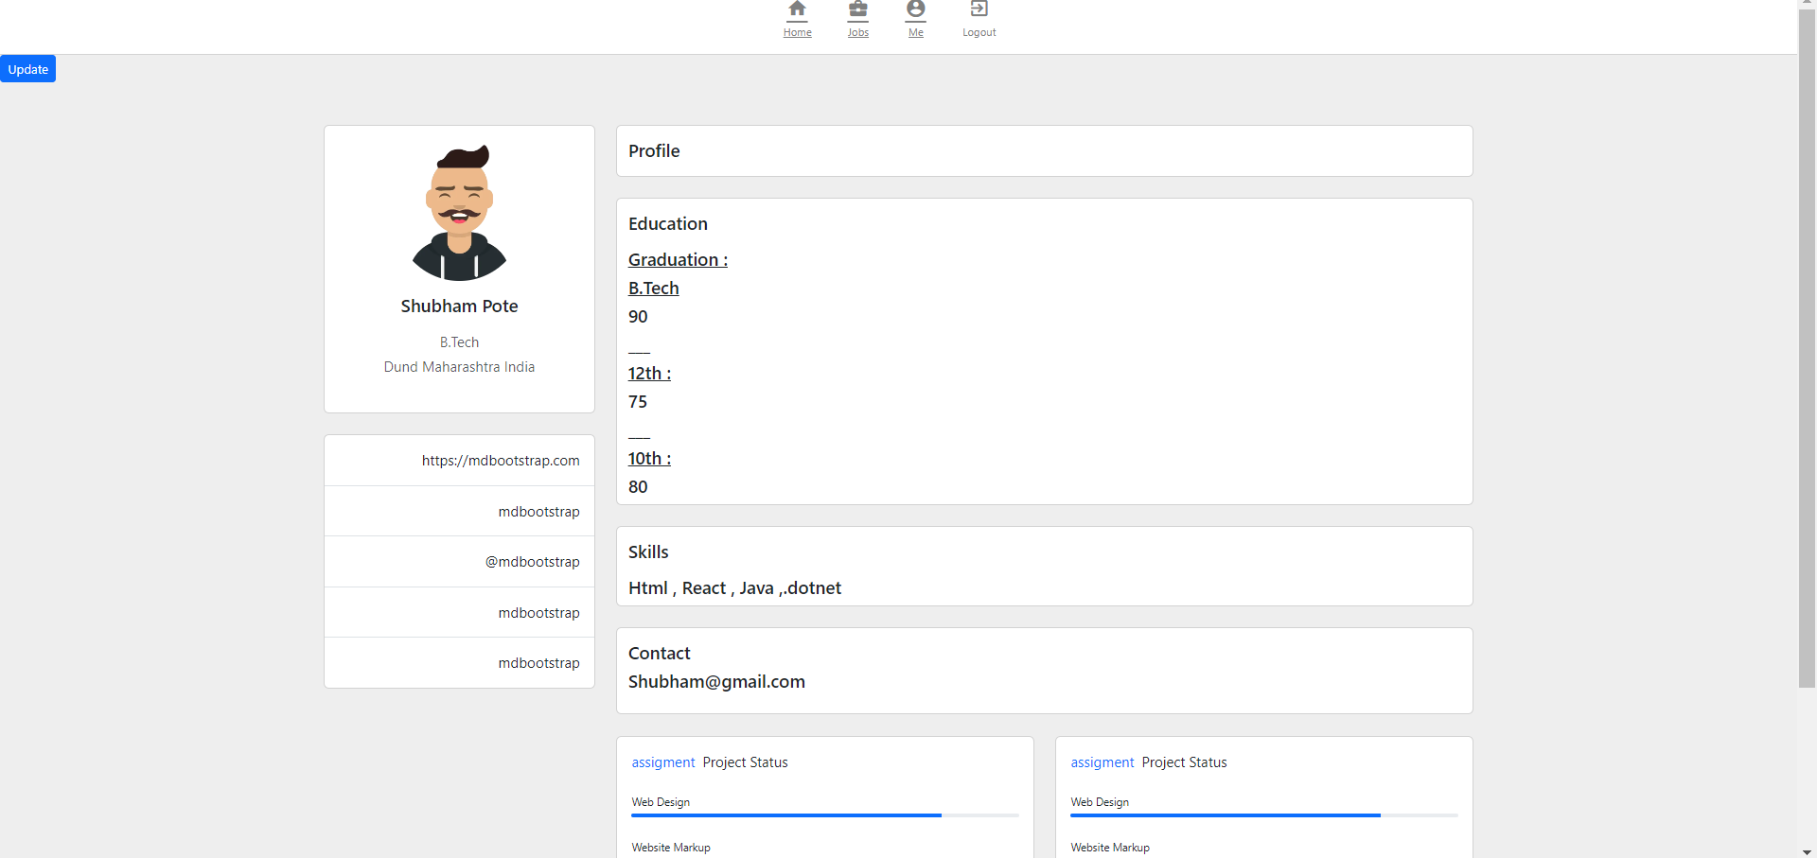
Jobseeker Profile

Slide 20
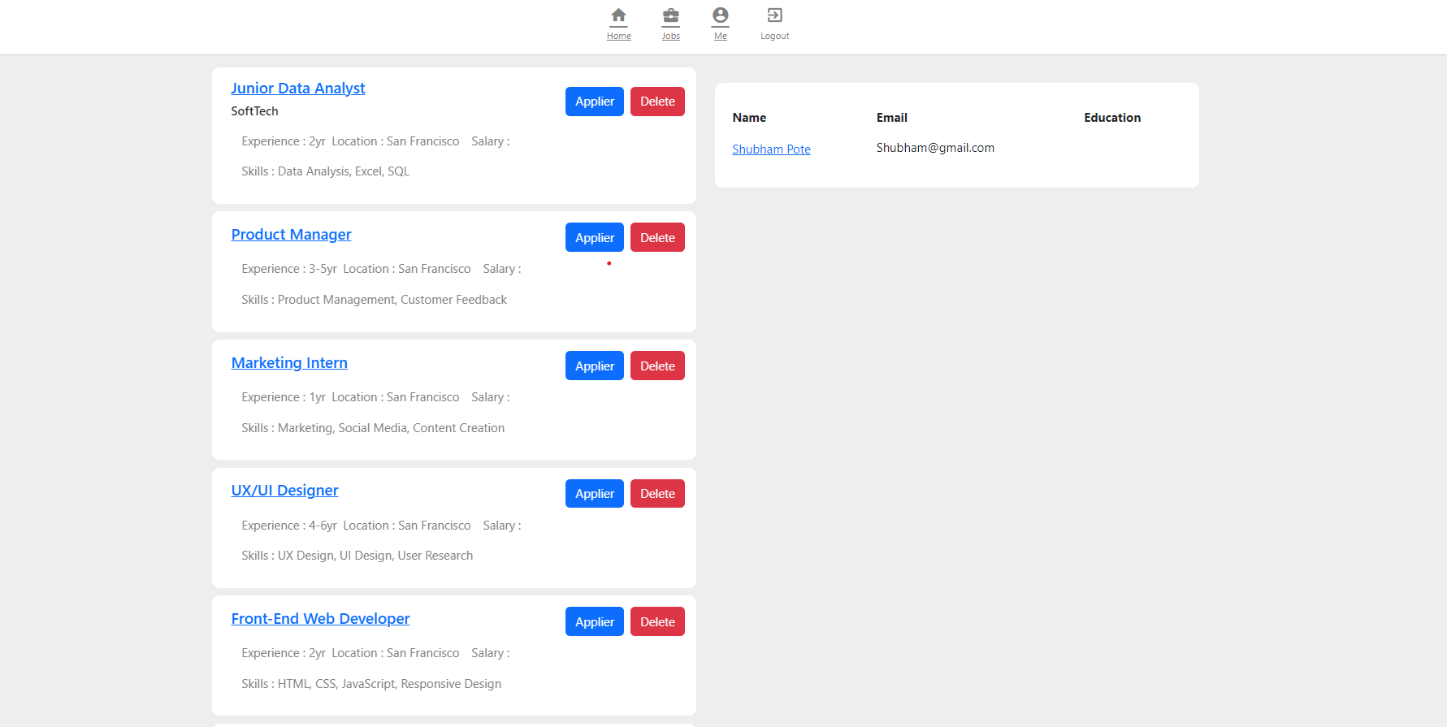
Recruiter view page

Slide 21
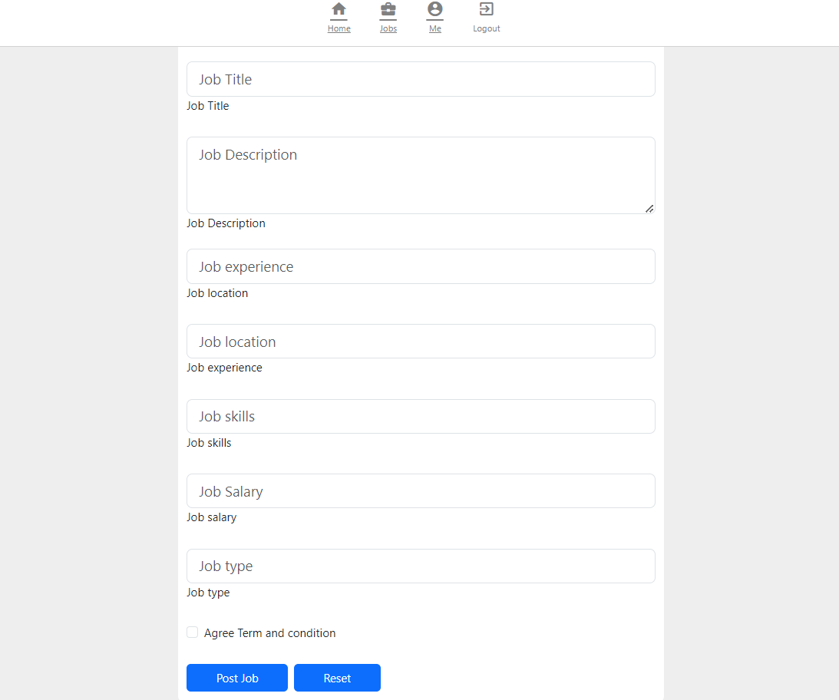
Job Posting view

Slide 22
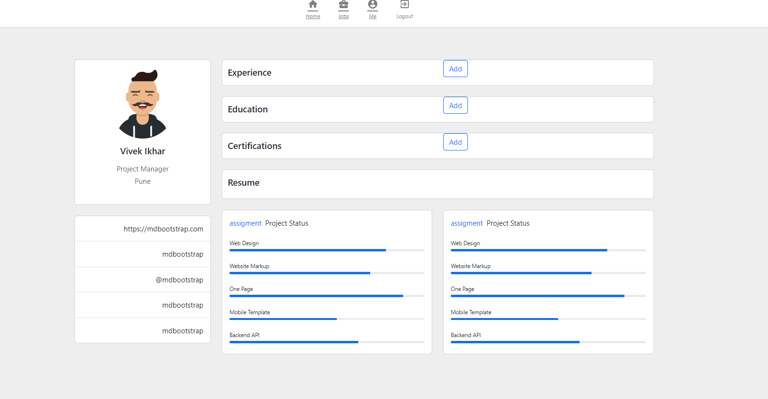
Recruiter profile

Slide 23
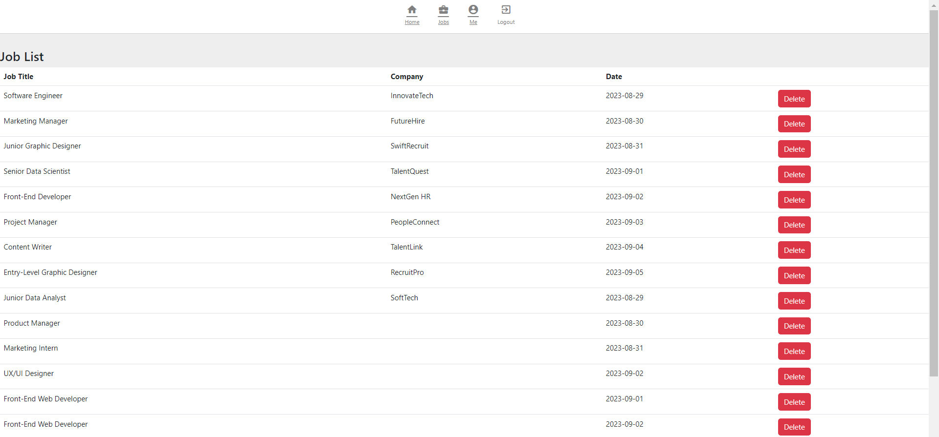
Admin profile

Slide 24
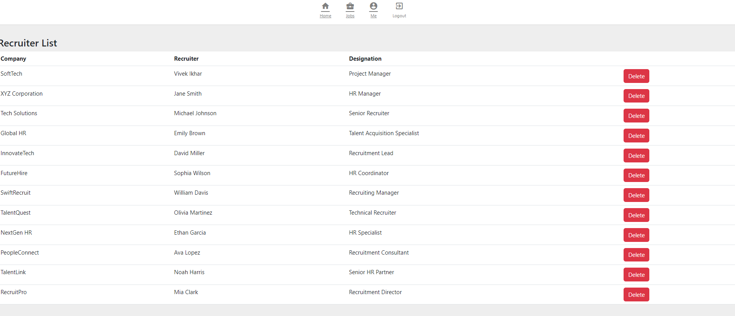
Admin Recruiter List

Slide 25
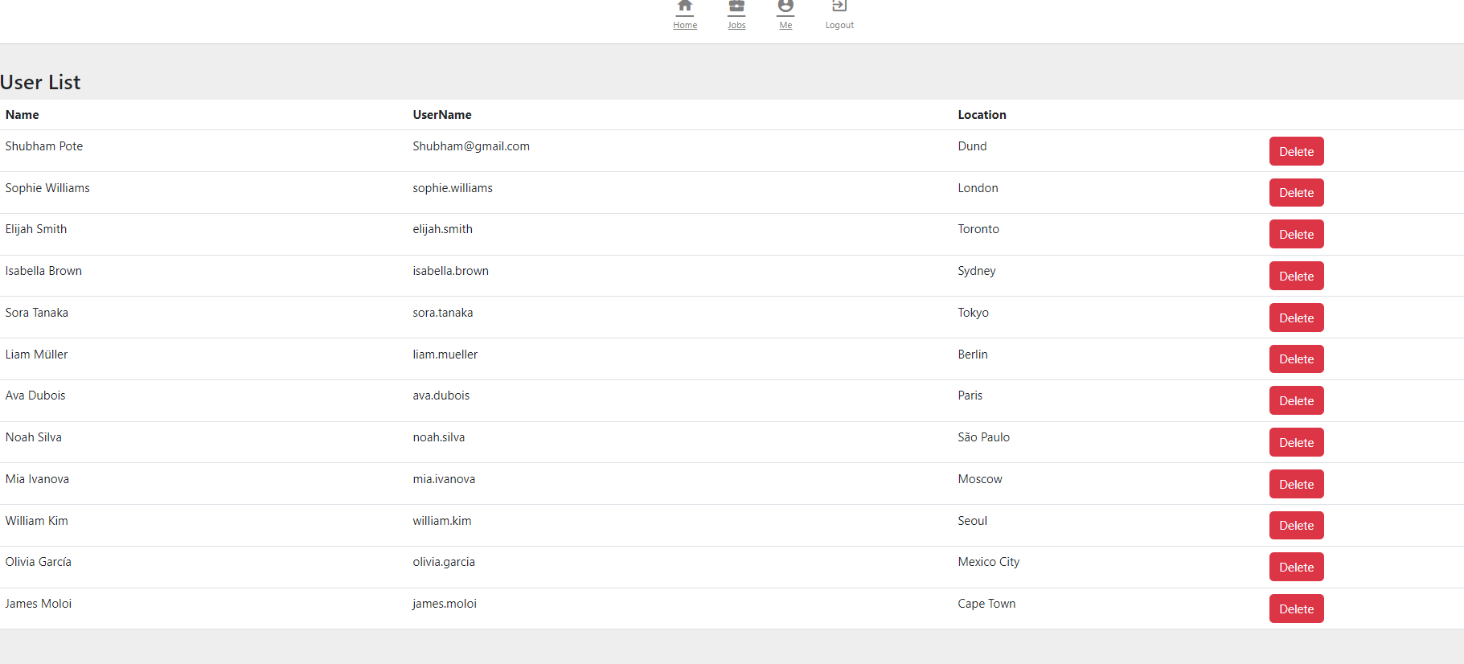
Admin Jobseeker List

Slide 26

Conclusion :-
The Online Job Portal is a powerful tool for modern job seekers and employers. By streamlining searches, improving access, and adapting to evolving work trends, it's a catalyst for career growth. Embracing the future of work, this portal is a gateway to efficiency and opportunity in the job market.

Slide 27
Thank You

